Slide 1
TILING FOR TOTS
A Study & Application of Golomb’s Tromino Theorem
Javid Fathi
December 23, 2019
CS-315-001: Honors Algorithms
Notes:
Bibliography, Referenced Sources:
[1] Befumo, Arthur, and Jonathan Lenchner. “Extensions of Golomb's Tromino Theorem.” The 24th Fall Workshop on Computational Geometry, University of Connecticut, 2014, https://fwcg14.cse.uconn.edu/program/wp-content/uploads/sites/863/2014/10/fwcg2014_submission_10.pdf.
[2] Bogomolny, A. (n.d.). Golomb's inductive proof of a tromino theorem. Retrieved from http://www.cut-the-knot.org/Curriculum/Geometry/Tromino.shtml.
[3] Fathi, J. (2019, December 14). Retrieved from https://scratch.mit.edu/projects/351295957/
[4] GeeksForGeeks. (2018, December 1). Tiling Problem using Divide and Conquer algorithm. Retrieved from https://www.geeksforgeeks.org/tiling-problem-using-divide-and-conquer-algorithm/.
[5] Golumb, Samuel W. “Checker Boards and Polyominoes.” The American Mathematical Monthly, vol. 61, no. 10, Dec. 1954, pp. 675–682.
[6] Jain, S. (2018, February 7). Divide and Conquer. Retrieved from https://www.comp.nus.edu.sg/~sanjay/cs3230/dandc.pdf.
[7] Midlandman. (2008, November 8). Retrieved from https://scratch.mit.edu/projects/751577/
[8] Tromino. (2019, November 17). Retrieved from https://en.wikipedia.org/wiki/Tromino.
[9] Valentine, M., Wallmark, L., & Anderson, A. (2007). Retrieved from https://aanderson.people.amherst.edu/tromino/

Slide 2
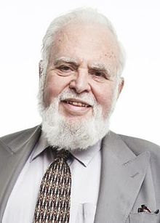
Abstract
In the mid-1950's, Harvard undergraduate Samuel Golomb published a theorem on tiling with trominoes.
In short, a square board of any size - made up of 2^{n} by 2^{n} tiles - can be filled with unit-sized L-shaped blocks, so long as one square unit tile was removed.
In addition to an educational companion software, this project develops/demonstrates:
Inductive and algebraic proofs for the Tromino Theorem;
Educational and theoretical applications of the Tromino Theorem;
Ways to introduce prospective computer scientists and engineers to algorithmic programming and problem-solving.

Slide 3
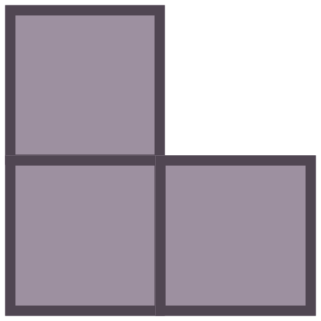
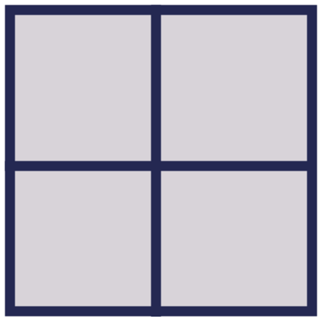
Problem Statement
GIVEN a square board of any size and composed entirely of square unit tiles,
PROVE that the board can be filled with “L-shaped” blocks of tiles, called trominoes,
SO LONG AS one square unit tile is filled or removed from the board.
This animation has already demonstrated Step One of the inductive proof. (We’ll return to this soon.)

Slide 4
Importance of Golomb’s Tromino Theorem
Golomb defined trominoes as a type of ‘polyomino:’
Composed of some natural integer number of contiguous, square unit blocks (i.e.: three);
And generally composed without empty blocks (or holes) inside of the object.
Familiarity with the Tromino Theorem is considered essential to understanding any other algorithm in the field of graph theory.
The Tromino Theorem is considered an excellent tool to introduce future engineers to algorithmic problem-solving skills and the principles of invariant-based programming.
Bridges the gap between purely visual and purely algorithmic problem-solving.

Slide 5
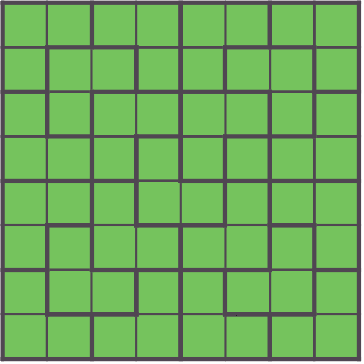
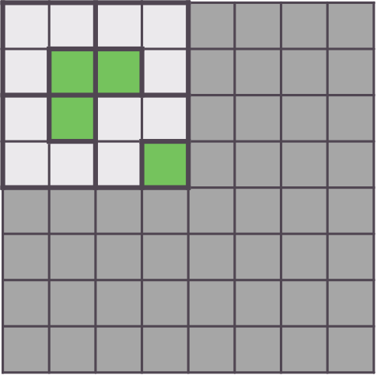
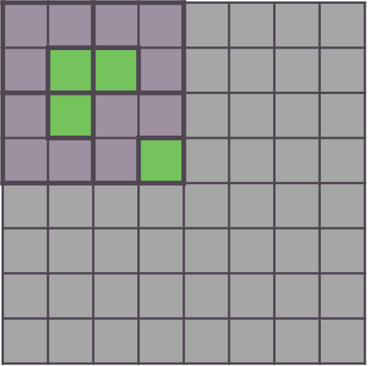
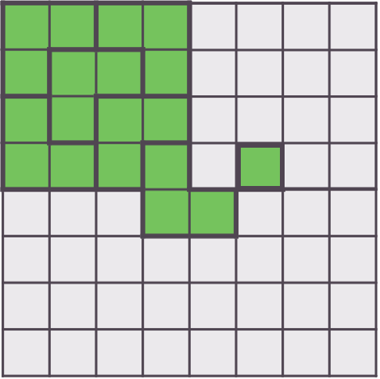
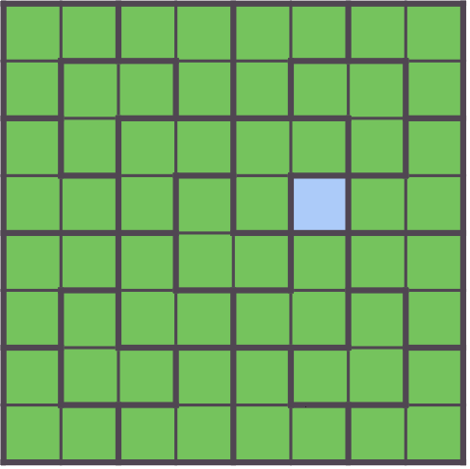
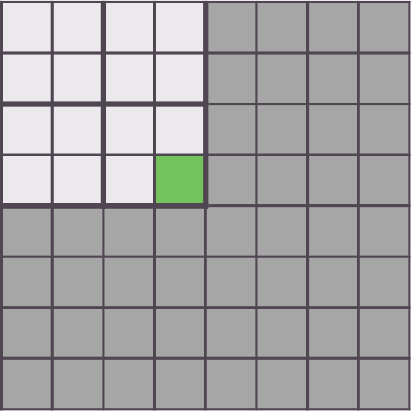
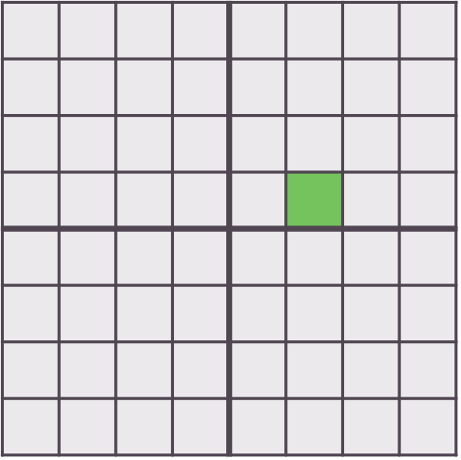
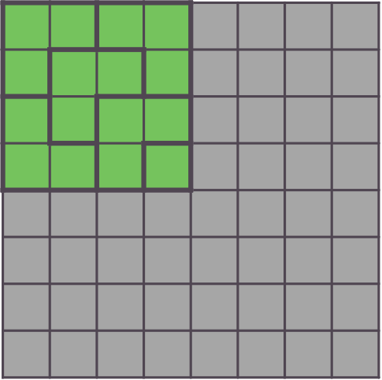
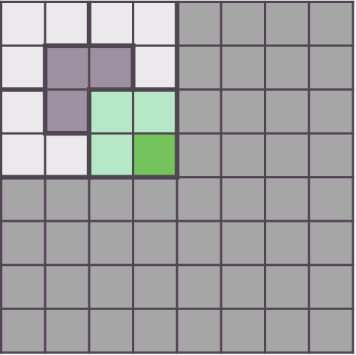
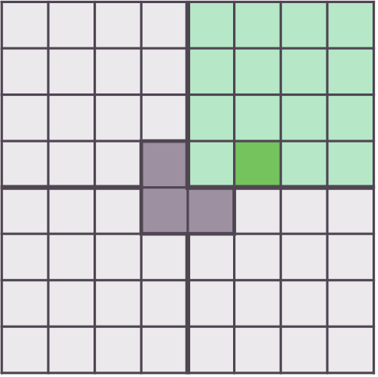
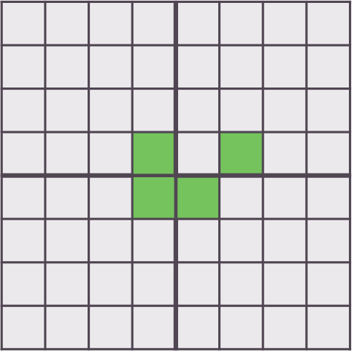
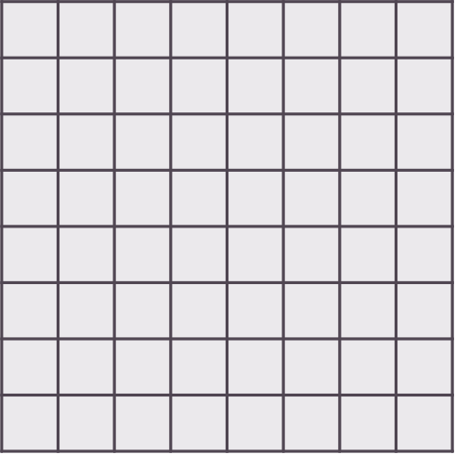
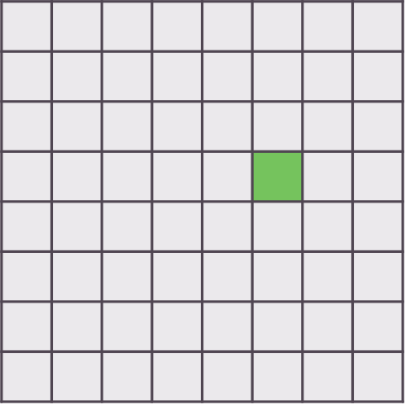
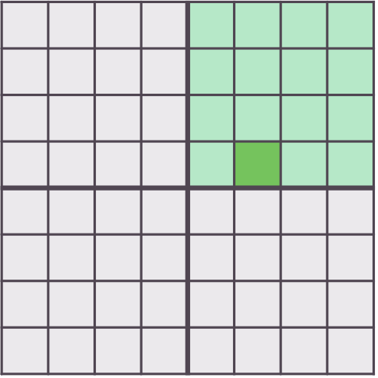

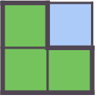
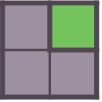
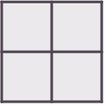
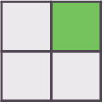
Demonstration of the Tromino Theorem
Let’s use an inductive algorithm to understand why Dr. Golomb’s Tromino Theorem holds true on a square board of any size.
We’ll call these Boards A & B, respectively.
We start by filling in a single tile on both boards. This removes the tile from play for the duration of either algorithm.
We’ll solve Board A first. It clearly needs only one right tromino.
Now we’ll partially solve for Board B. See if you can identify the inductive algorithm being used.
A
B
Notes:
Visual algorithm explained during discussion. Feel free to replay Board B if necessary. See Slide 8 for additional assistance.

Slide 6
Proving the Tromino Theorem
Why does this work?
Breaking up square board (2^{n} * 2^{n}) into smaller quadrants (2^{n-1} * 2^{n-1}).
Principle of Invariants:
A square board always has 2^{n} x 2^{n} tiles – s.t. n is a natural integer (n >= 1).
Removing one tile:
(2^{n} * 2^{n} – 1) = (2^{(n+n)} – 1) = ((2²)^{n} – 1) = (4^{n} – 1) = (4^{n} – 1^{n})
Binomial theorem applied:
(4^{n} – 1) = (4 – 1)[4^{n-1} + … + (4⁰)(1^{n})] = 3(4^{n-1} + … + 1)
Problem continues recursively. One tile ‘removed’ from each quadrant by base condition or a tromino overlapping across contiguous borders.
Proof by Induction:
Base Case: (n = 1); 4 tiles, Board A. known to be possible. ((4¹ – 1) % 3 = 0)
Inductive Case: (n = k); assumed to be possible. ((4^{k} – 1) % 3 = 0)
Next Case: (n = k+1):
= ((4^{k+1} – 1) % 3) = ([4(4^{k}) – 1] % 3)
= ([4(4^{k}) – 1 – 3] % 3)
= ([4(4^{k}) – 4] % 3)
= ([4(4^{k} – 1)] % 3)
= ((4^{k} – 1) % 3 = 0).
Therefore, it is proven by induction that trominoes of tiles can fill any square board of tiles, so long as a single tile is removed from the board.

Slide 7
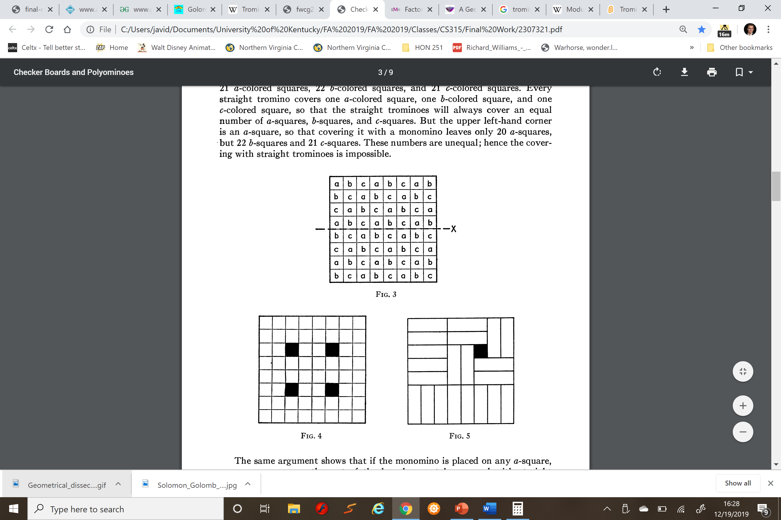
Additional Properties of Golomb’s Tromino Theorem
In the same publication that Dr. Golomb introduced the Tromino Theorem, he also identified potential limitations to it implementation.
He asserted that the tromino used on the square board – in his case, it was a 64-tile chess-board – must be ‘L-shaped’ either to the right or the left for the theorem to hold regardless of the board size or the position of the tile removed.
If the tromino is straight, then there are only 4 possible tiles chess-board which can be removed such that the 8x8 board can be filled. Impossible for a 2x2 board!
Furthermore, research conducted by a computer scientist and a high schooler have indicated that altered versions of Golomb’s Tromino Theorem can be applied to boards and hypercubes of higher dimensions [i.e.: (3^{n} * 3^{n}) or (4^{n} * 4^{n}) tiled structures].

Slide 8

Added Value: Software Implementation
A simple educational game was developed to demonstrate Golomb’s Tromino Theorem and to test student understanding of the algorithm. For the game to be easily accessible to high schoolers and middle schoolers, ‘Trominoes! Trominominoes!’ was developed using Scratch.
Notes:
Continue visual explanation of theorem, if necessary.

Slide 9
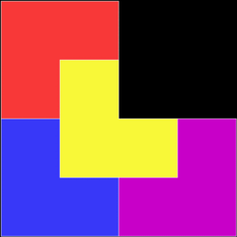
Concluding Remarks
Companion software has already been used to teach non-engineering students about Golomb’s Tromino Theorem. Students have reportedly found the game engaging and fun.
Golomb’s Tromino Theorem largely serves two purposes in the modern study of algorithms:
To engage students in deconstructing visual problem through inductive and algorithmic strategies.
And to introduce future engineers to the fundamentals of Graph Theory.
Future work may include creation of a simple program that can determine and display inductive solutions for a given, unfilled board.

